Slide 1
SIG-Service Catalog Deep-Dive Mateusz Szostok, SAP

Slide 2
You will learn
Open Service Broker API Specification
Status of CRD implementation
New release process
New subprojects that we own
Design Issue - Cascade deletion proposal
Design Issue – GUIDs vs Names
Future plans

Slide 3

Open Service Broker API
API for the automated deployment, management, and use of services
Cloud-native apps require resources such as stable storage
App developers shouldn’t have to care about how the service is managed
Client side implemented by Service Catalog
managed through custom resource types
Server side implemented by service provider as a ‘broker’
get catalog endpoint
provision service endpoint
bind service endpoint
Notes:
Similar introduction to the one you had

Slide 4
The Magic
Kube
Secret
App
1. Register Service Broker
2. Retrieve the Catalog of Services
3. Create a new Service Instance
Platform asks Brokers for Instance
4. Deploy Application
Broker
5. Bind Instance to an Application
Platform asks for new Binding/Creds
6. Access Service from Application
Using Creds from Binding Secret
Notes:
Similar introduction to the one you had

Slide 5
Service Catalog
Open Service Broker API
ClusterServiceBroker (and namespaced Servicebroker)
A server running somewhere that offers various services, e.g. MySQL Broker
ClusterServiceClass (and namespaced ServiceClass)
A category of services offered by a Broker, e.g. MySQL Databases
ClusterServicePlan (and namespaced ServicePlan)
A specific type of a Service that a Broker offers, e.g. 100 MB MySQL Databases
ServiceInstance
A single instantiation of a Service/Plan, e.g. Matt’s 100 MB MySQL Database
ServiceBinding
A unique set of creds to access a specific Instance, e.g. username/password for Matt’s 100 MB MySQL Database
Notes:
Similar introduction to the one you had

Slide 6
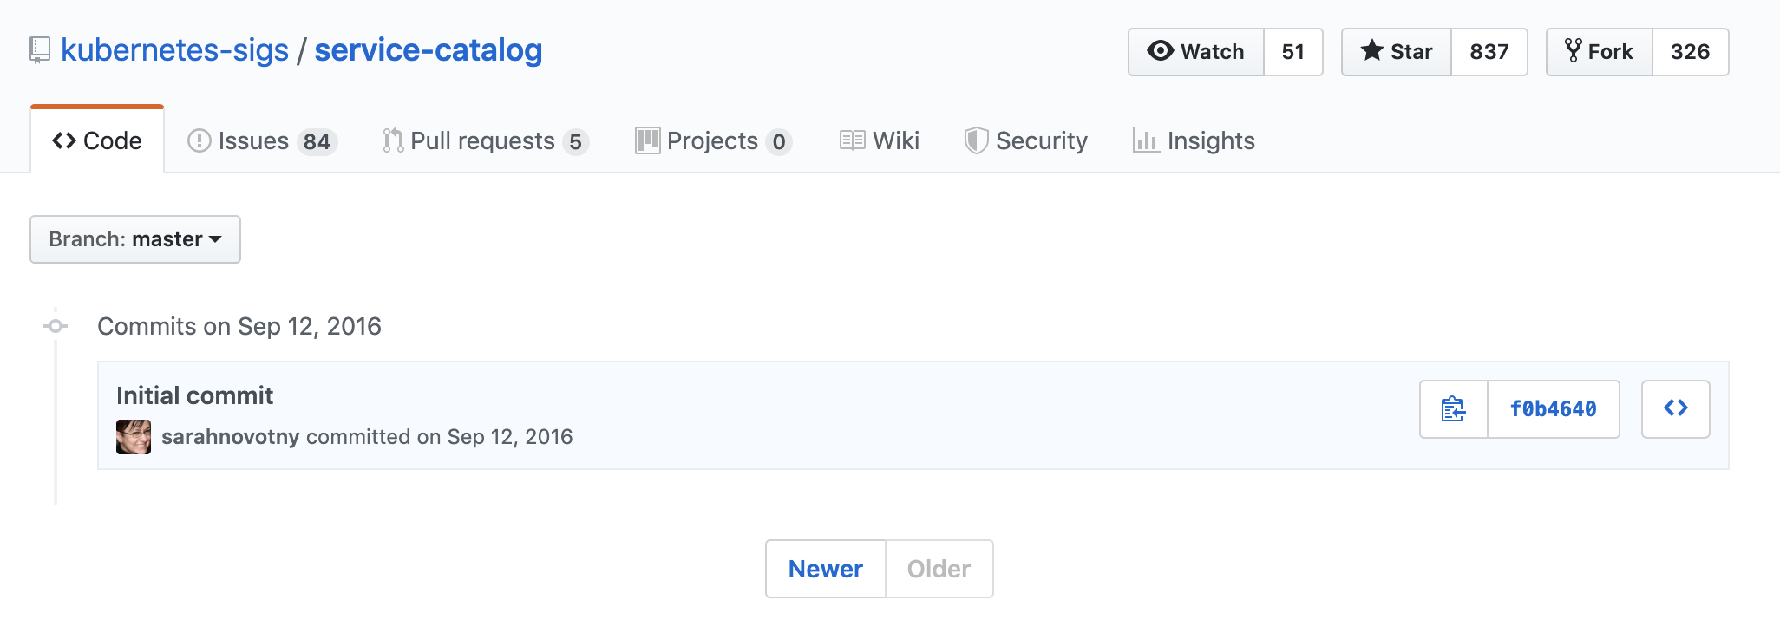
Long long time ago
Notes:
Describe why Service Catalog had the Aggregated API Server

Slide 7
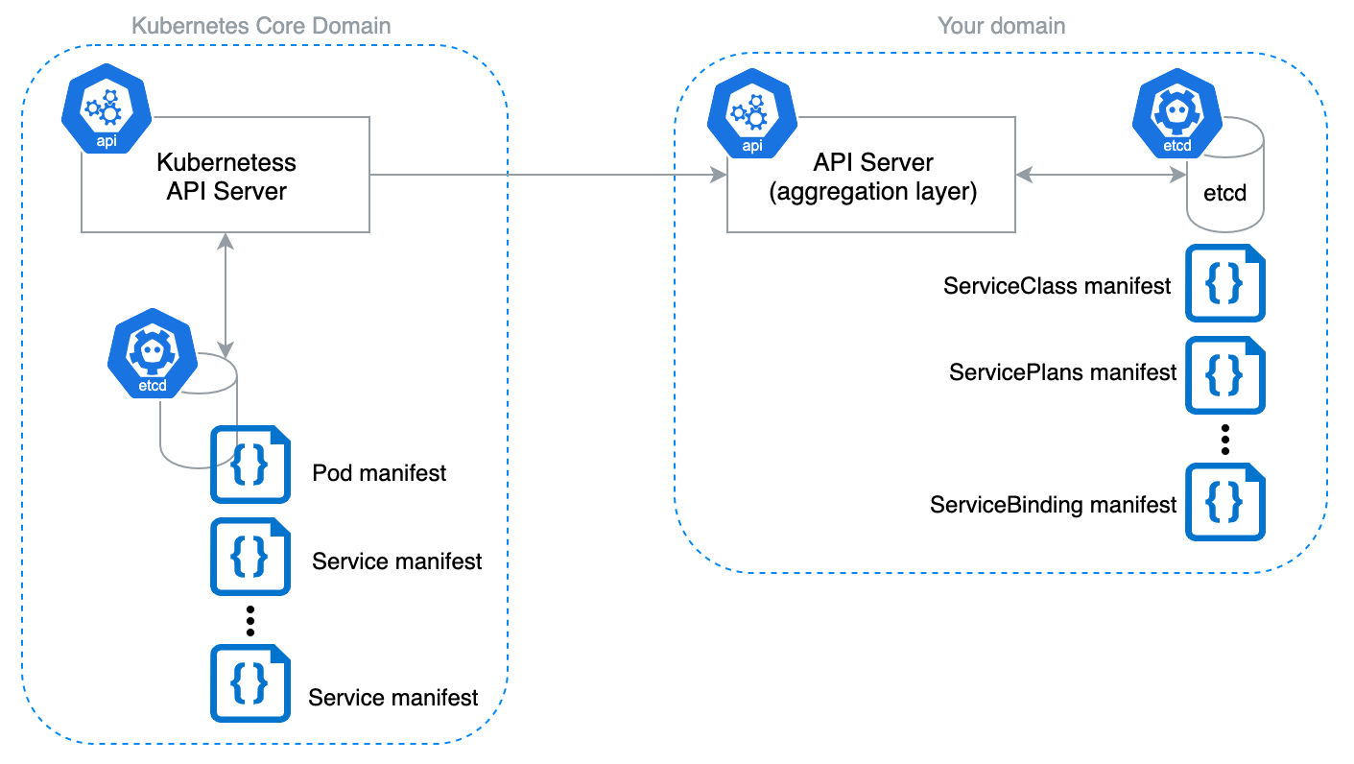
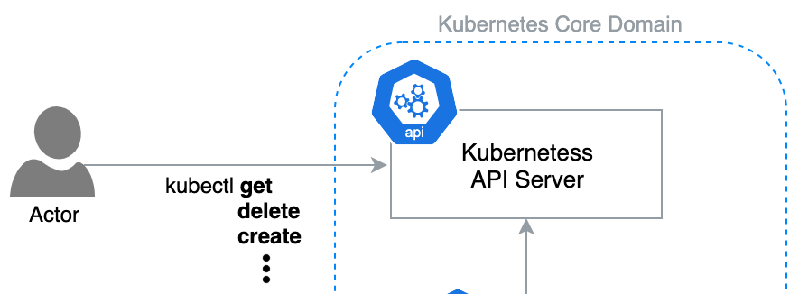
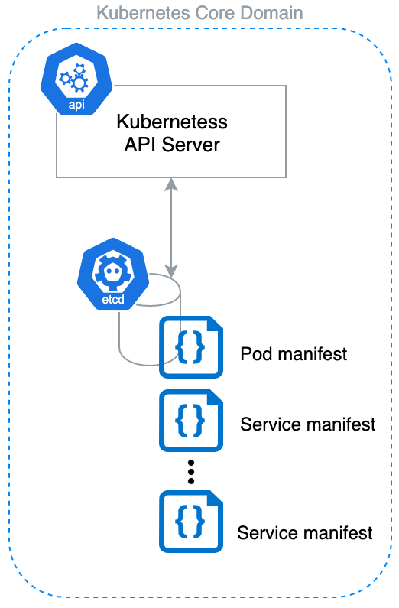
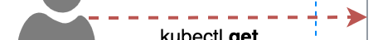
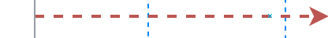
API Server Architecture

Slide 8
?
How good architecture goes bad
a.k.a why it's worth switching to CRDs in your project
Notes:
Briefly describe why we moved to CRDs

Slide 9
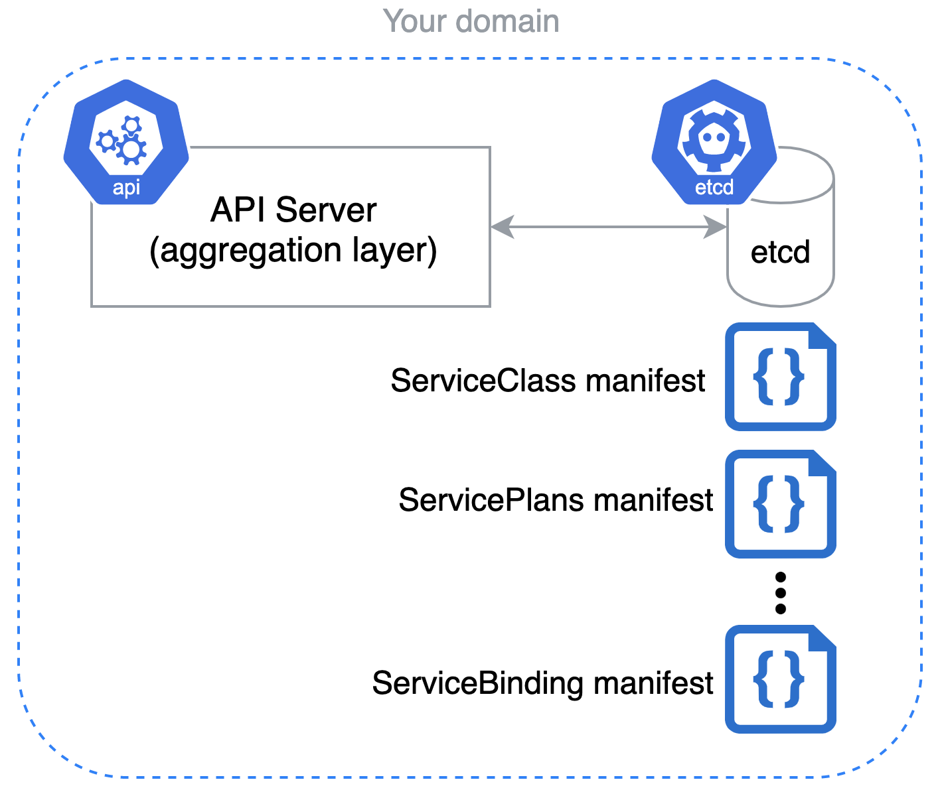
reason 0

Slide 10
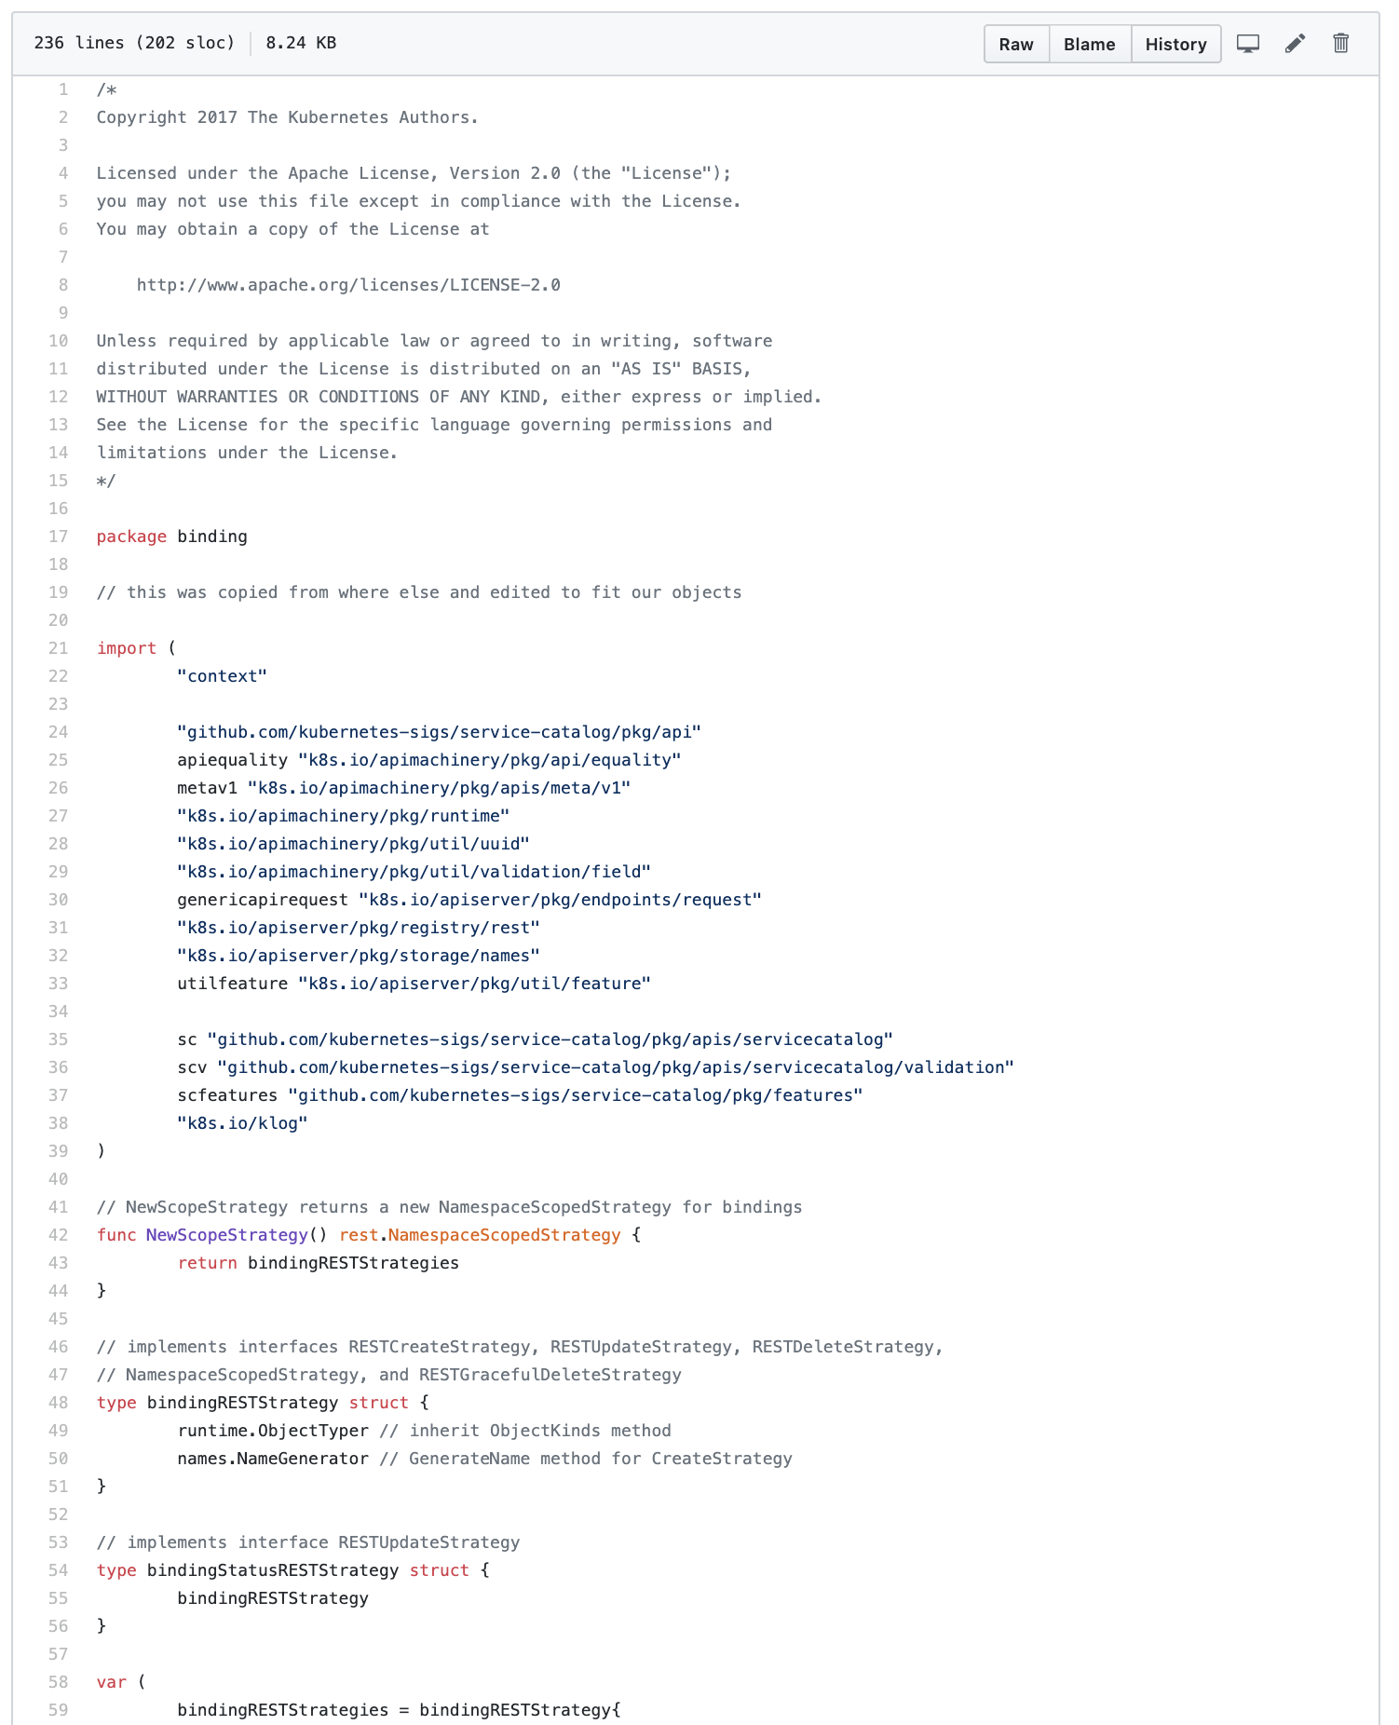
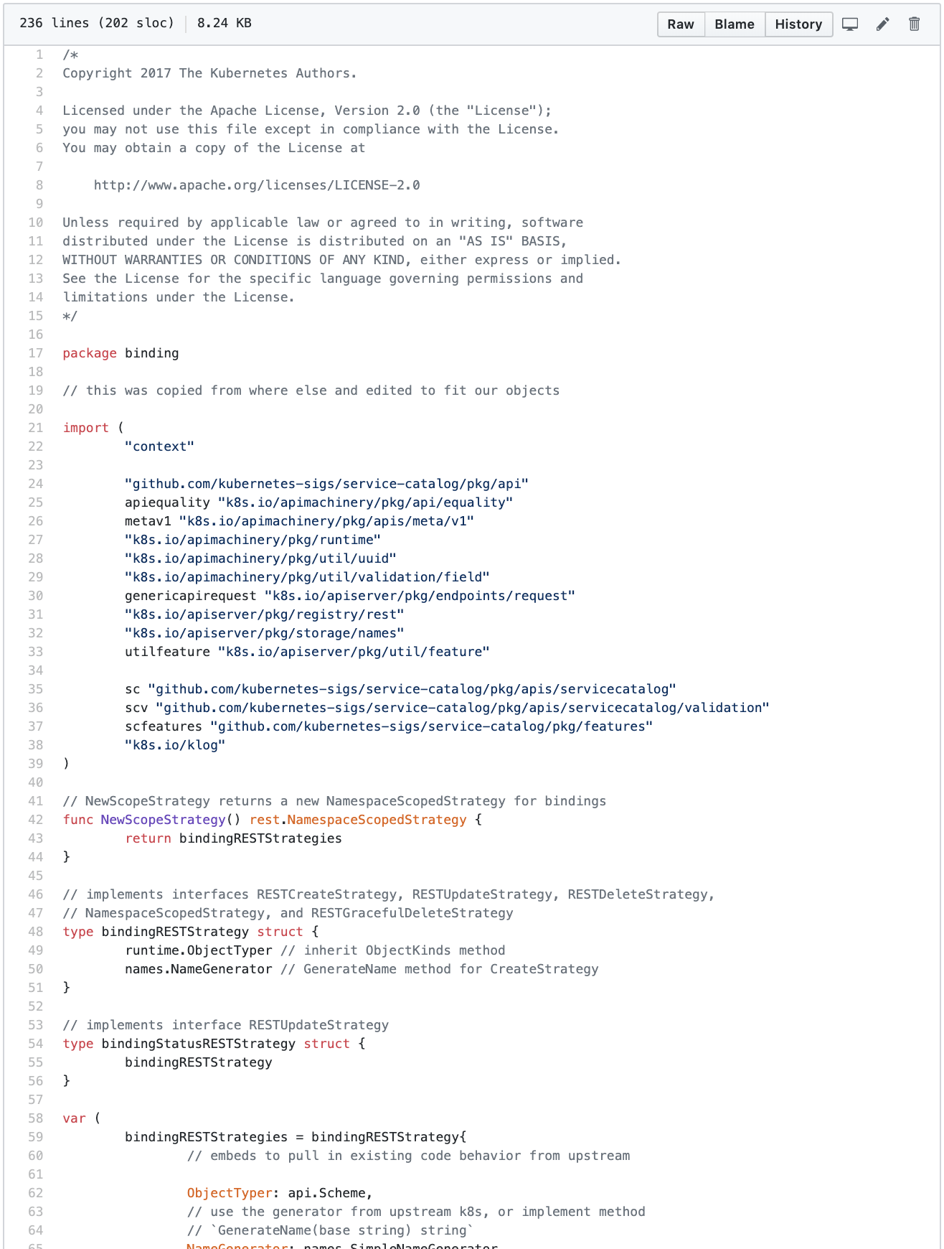
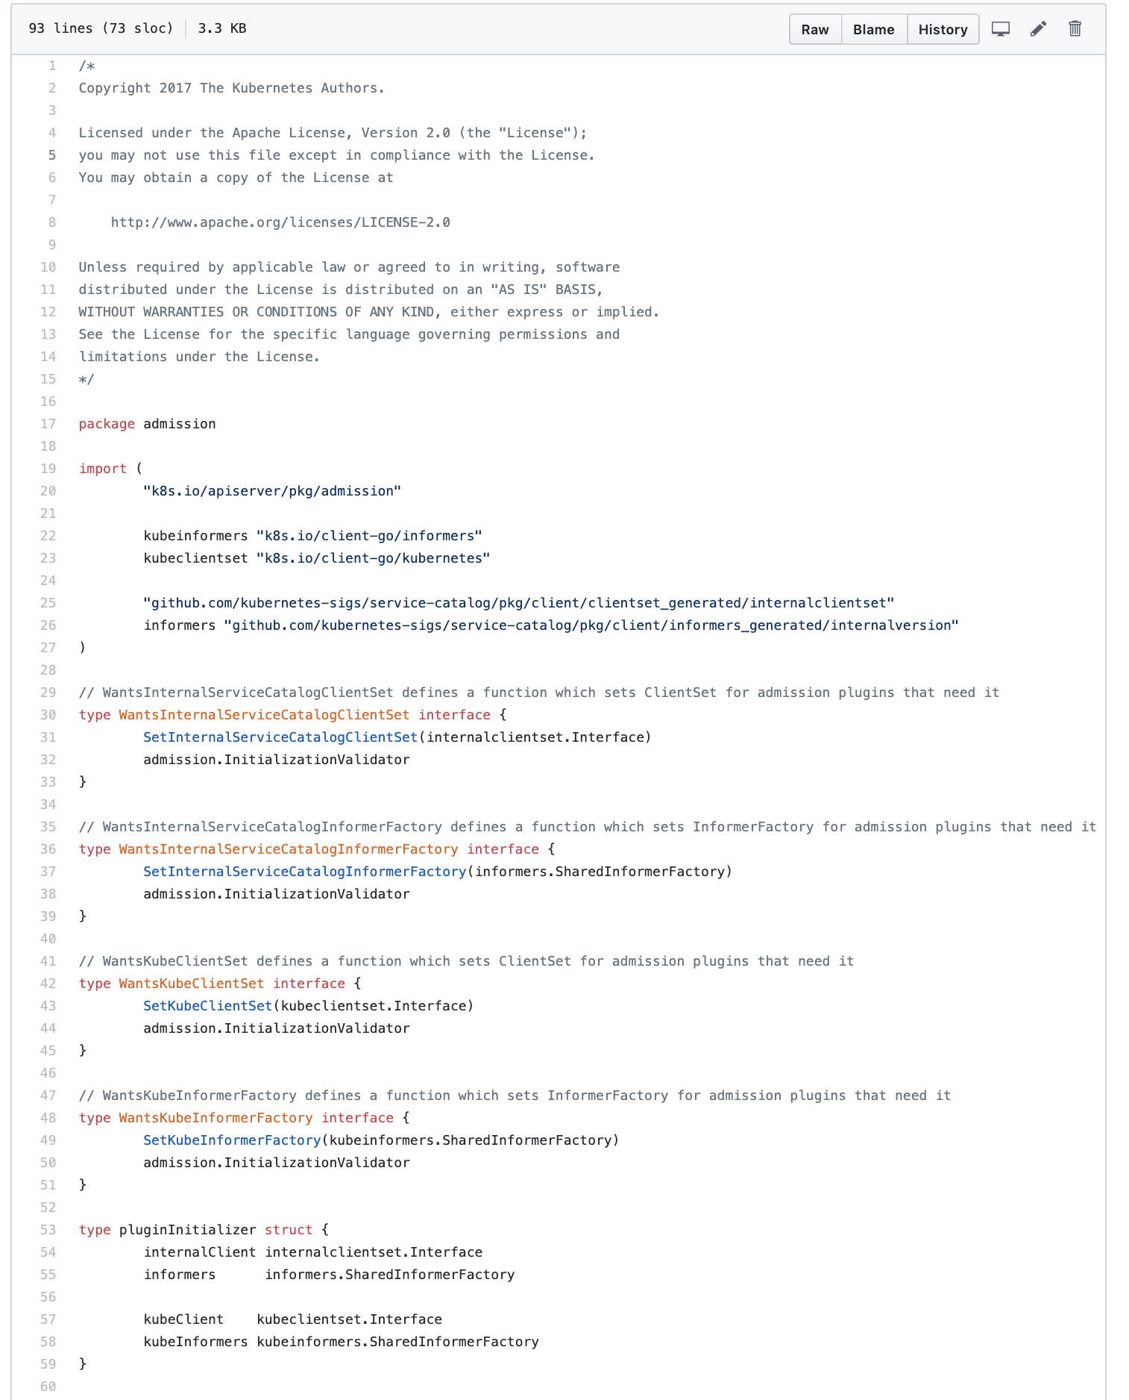
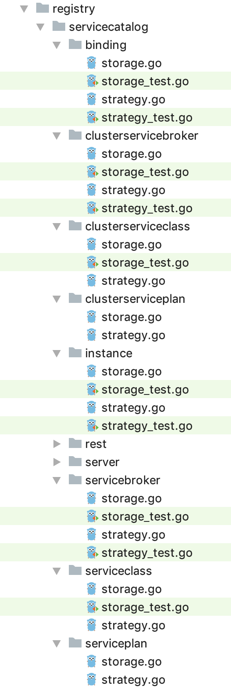
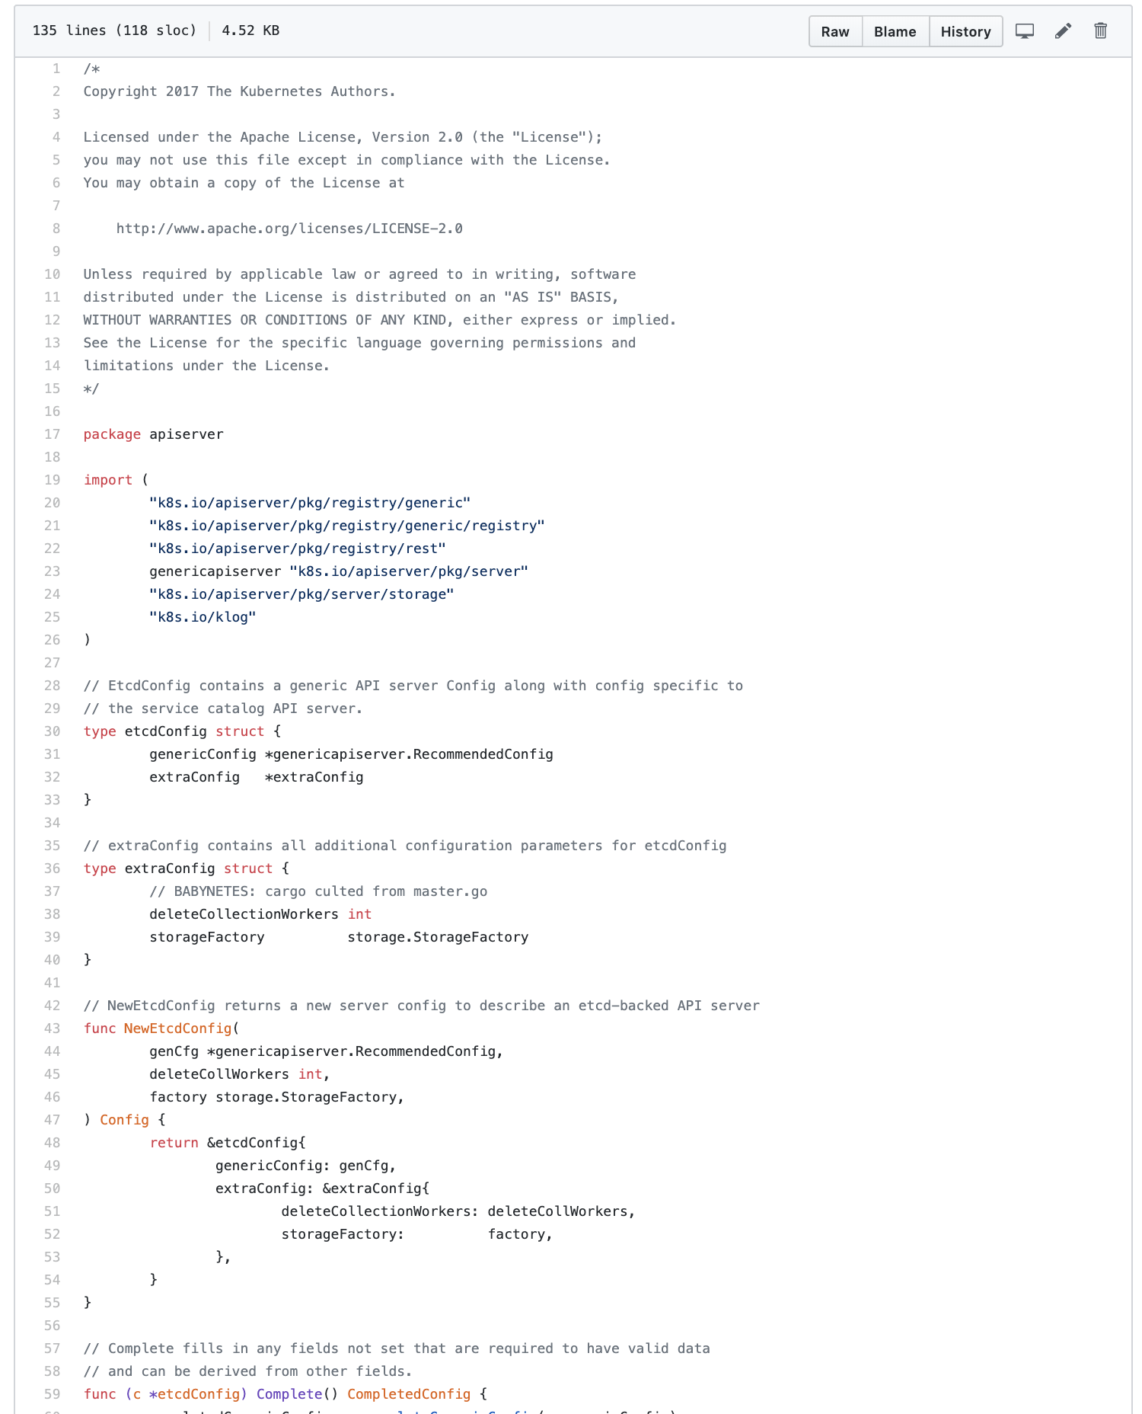
reason 0

Slide 11
reason 1
A lot of code
Problem: Owning a lot of code which is not directly connected with your business logic.

Slide 12
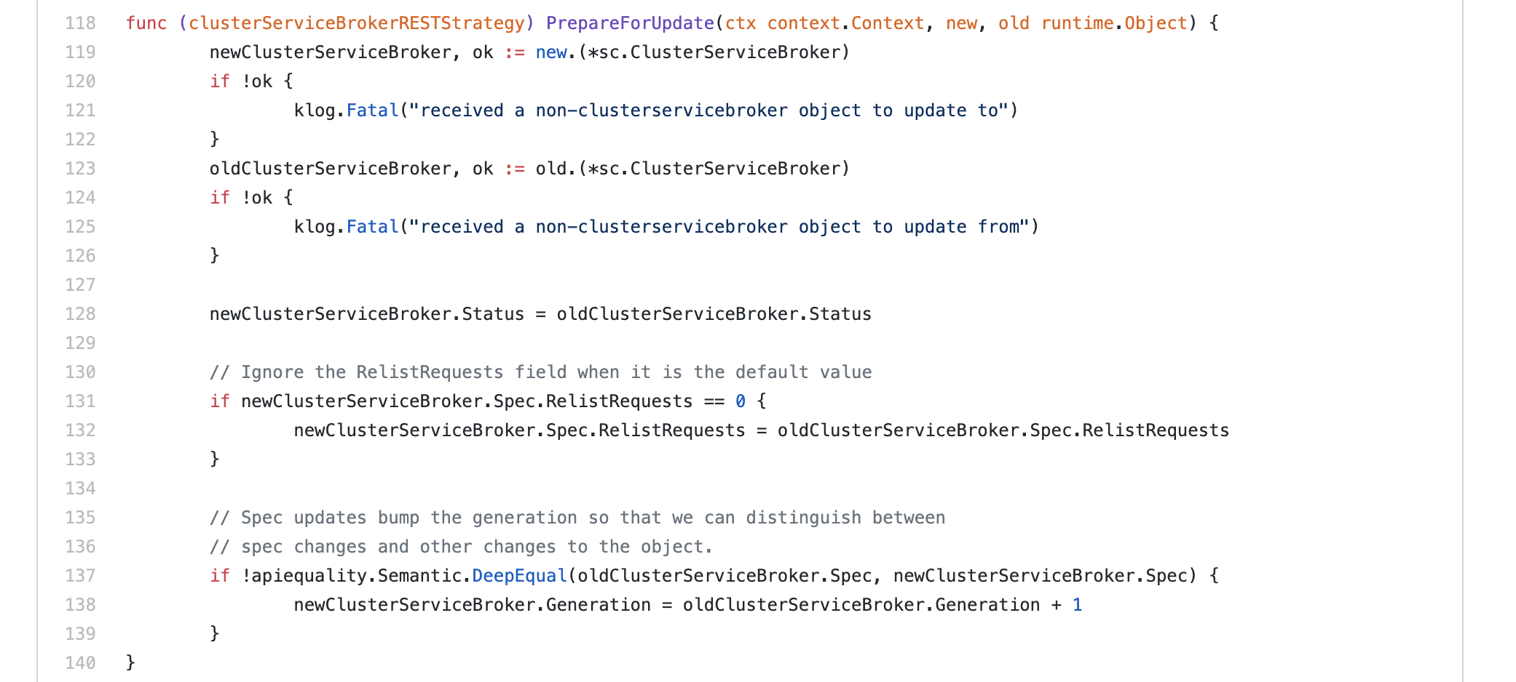
reason 1

Slide 13
reason 1
Duplicating core logic
Problem: Easy to introduce bugs
Problem: Hard to follow best practices

Slide 14
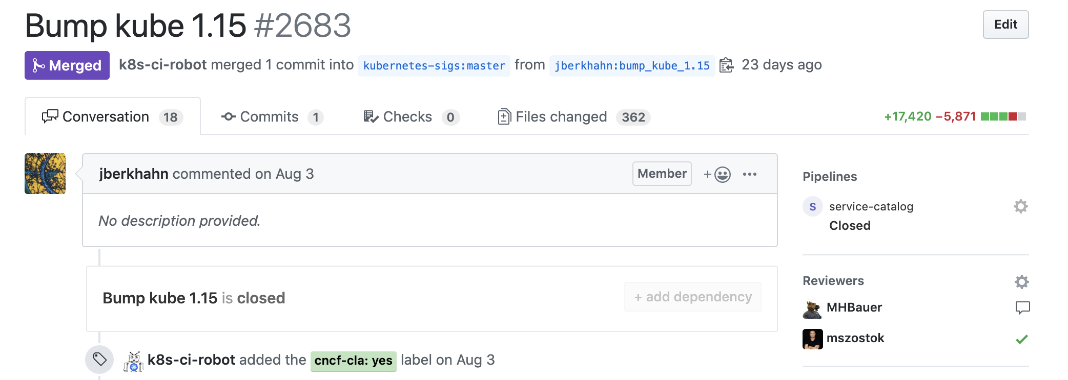
reason 2

Slide 15
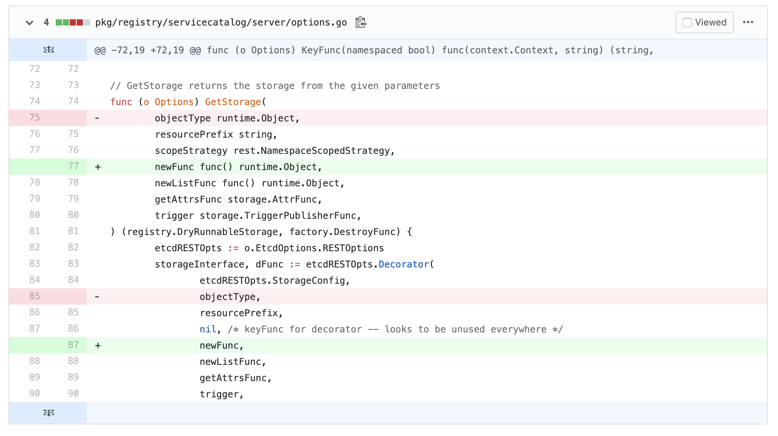
reason 2

Slide 16
reason 2
Be in sync with Kubernetes version
Problem: a lot of manual changes

Slide 17
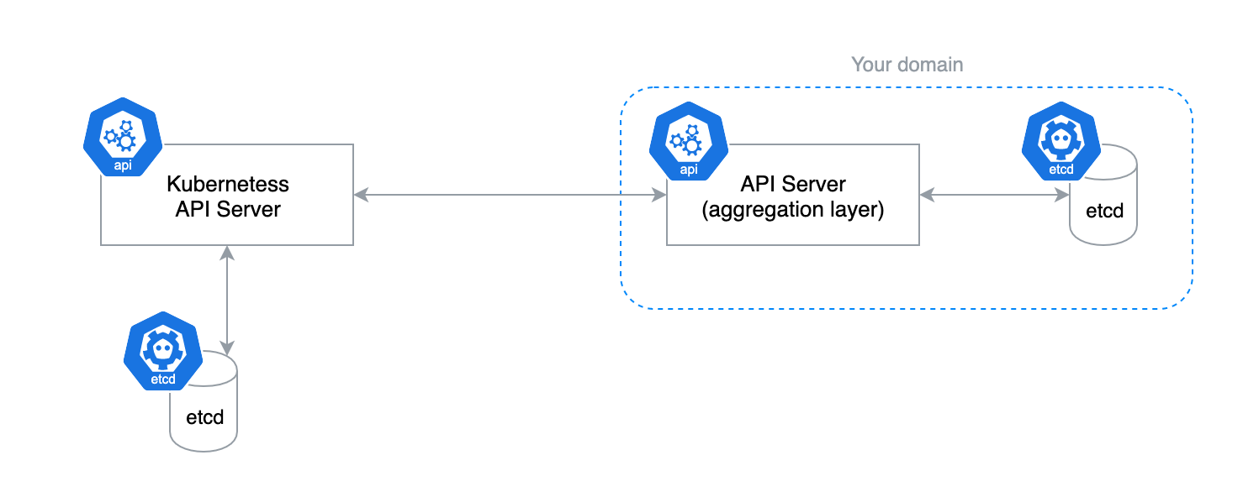
reason 3

Slide 18
reason 3
Requires own etcd storage
Problem: Our clients need to maintain an additional database for managed Kubernetes installation.

Slide 19
New kid on the block

Slide 20
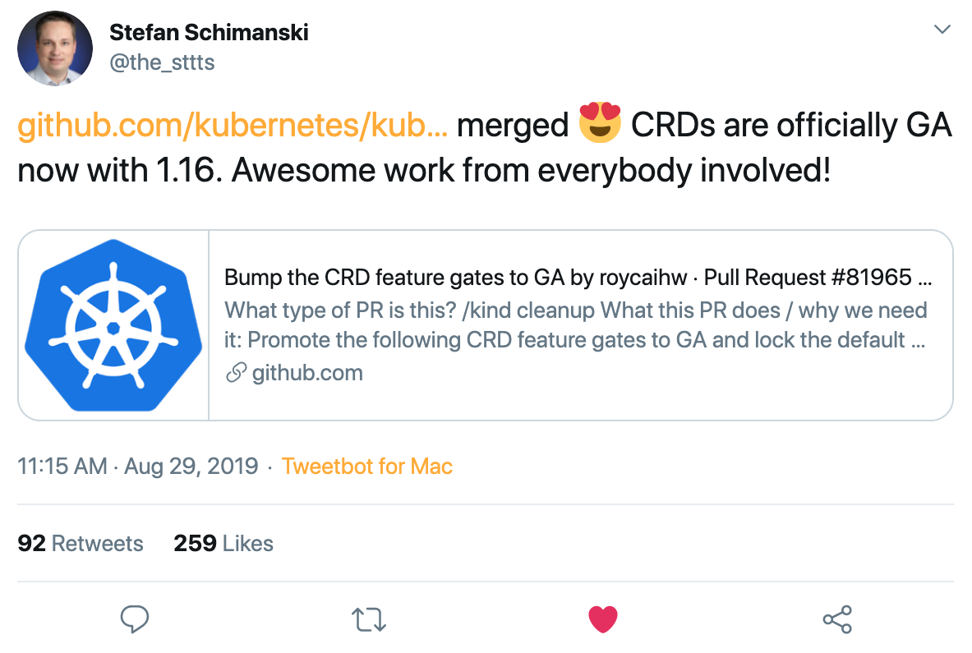
New kid on the block

Slide 21
How hard could CRUD be?

Slide 22

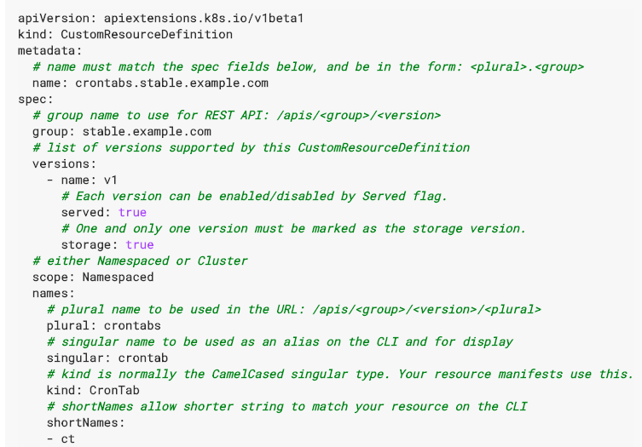
How hard could CRUD be?

Slide 23
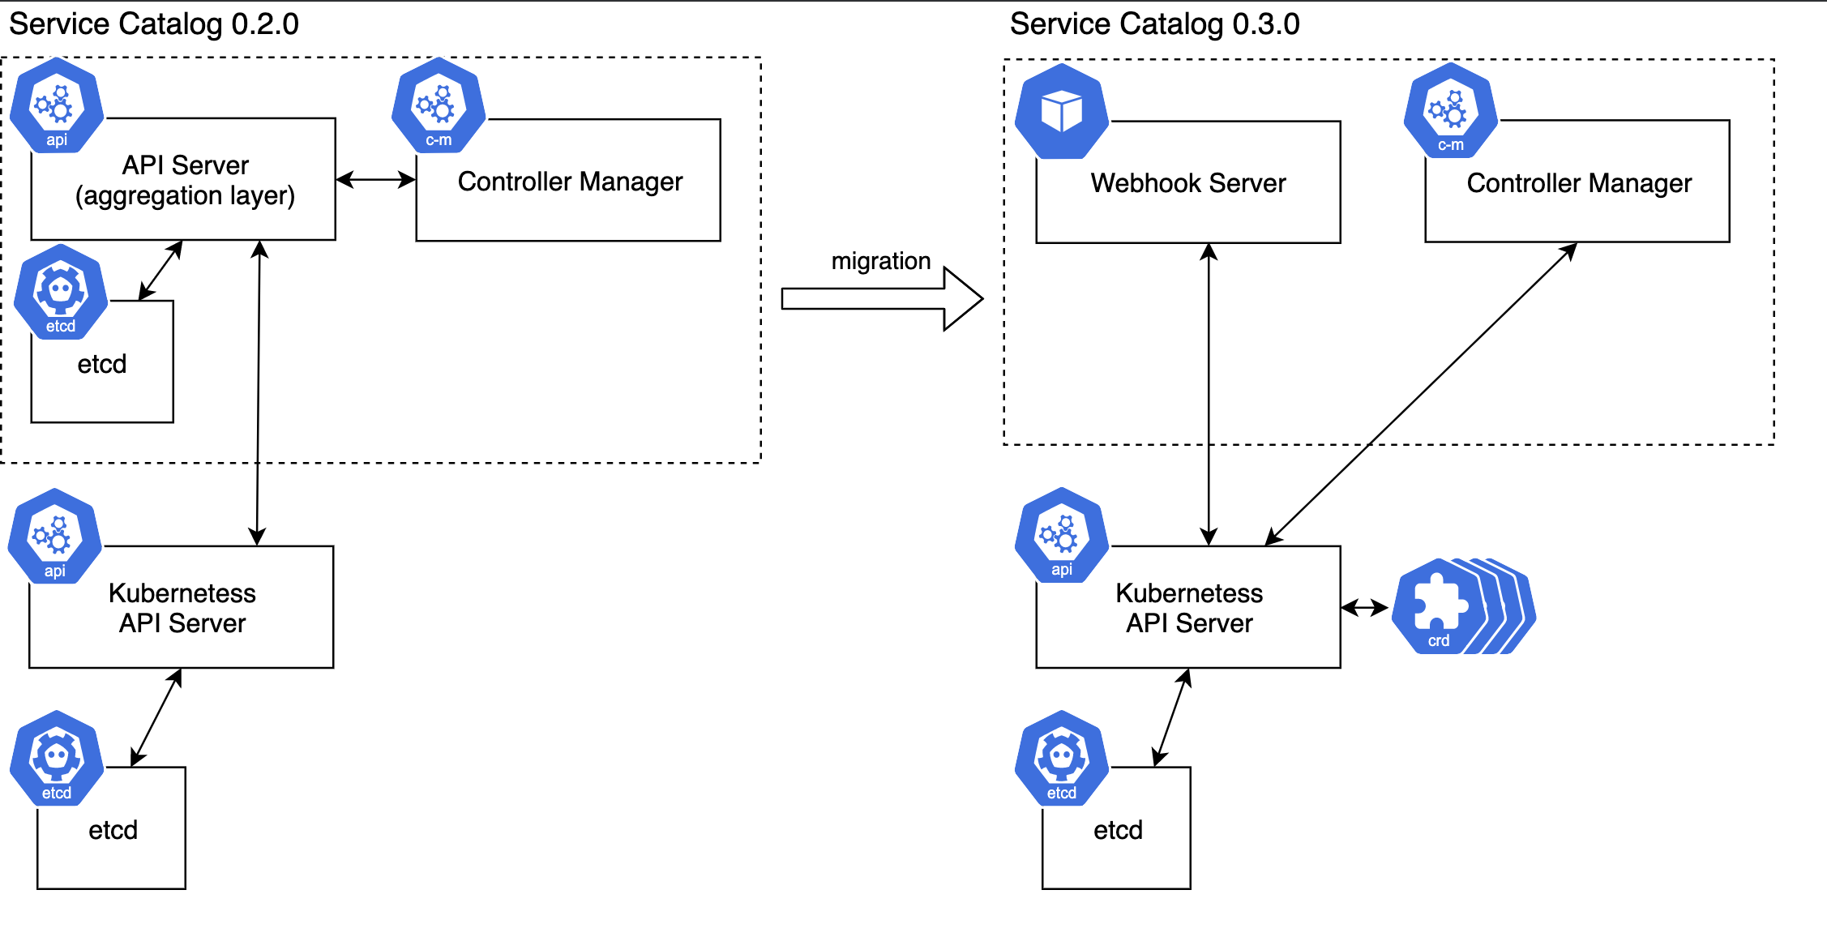
New architecture
Notes:
Show them the new architecture and describe it briefly

Slide 24
?
How did we move our features

Slide 25
Migrate features
Subresource
A custom sub-resource allows you to define fine-grained actions on its Kind.
For example, user writes spec section, controller writes status section.
TableConvertor
API Server uses TableConvertor
for printing custom columns
on kubectl get command.
PrepareForCreate/Update func
Functions to adjust newly created resources or updates existing ones.
Validation
API Server uses plugins which are gathered
and registered as validators.
FieldSelector
Restricts the list of
returned objects by their fields.
Notes:
The whole story took us about 5 months but it is not possible to squeeze a few months of work into 30minutes talk, so
On the slide you see only the 5 most important aggregated api server features
And I will show only how we substituted the FieldSelector in the CRD approach because it was the most problematic part.

Slide 26
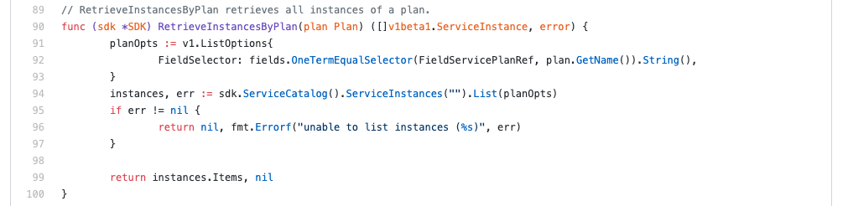
FieldSelector

Slide 27
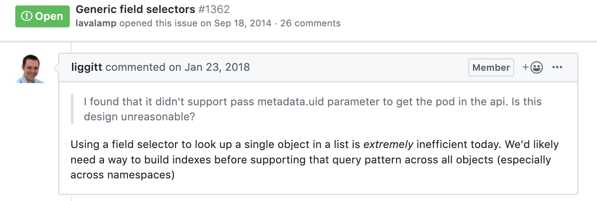
CRDs - Field Selector

Slide 28
Label me!
apiVersion: servicecatalog.k8s.io/v1beta1
kind: ClusterServiceClass
metadata:
name: sample-cluster-class
labels:
servicecatalog.k8s.io/spec.clusterServiceBrokerName: 6ca41896e...// <- sha224
servicecatalog.k8s.io/spec.externalID: f4947a36695f7a77... // <- sha224
servicecatalog.k8s.io/spec.externalName: 730d36fa34c1b3308... // <- sha224
spec:
bindable: true
bindingRetrievable: false
clusterServiceBrokerName: ups-broker
description: A user provided service
externalID: 4f6e6cf6-ffdd
externalName: user-provided-service
planUpdatable: true

Slide 29
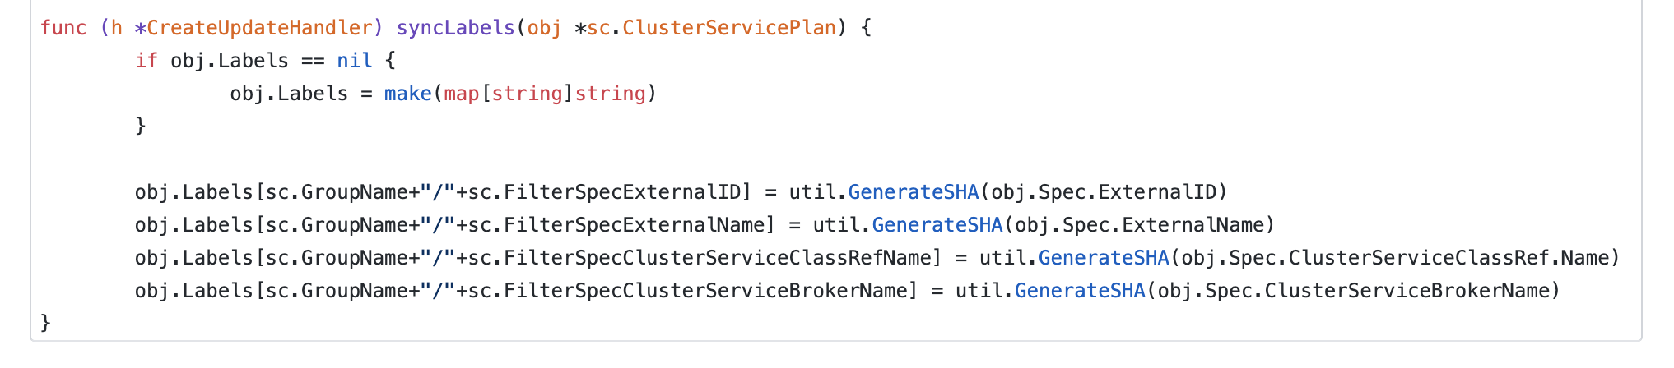
Label me!

Slide 30
Label me!

Slide 31
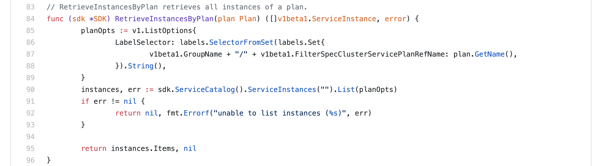
Label me!

Slide 32

Video about migrating other features

Slide 33
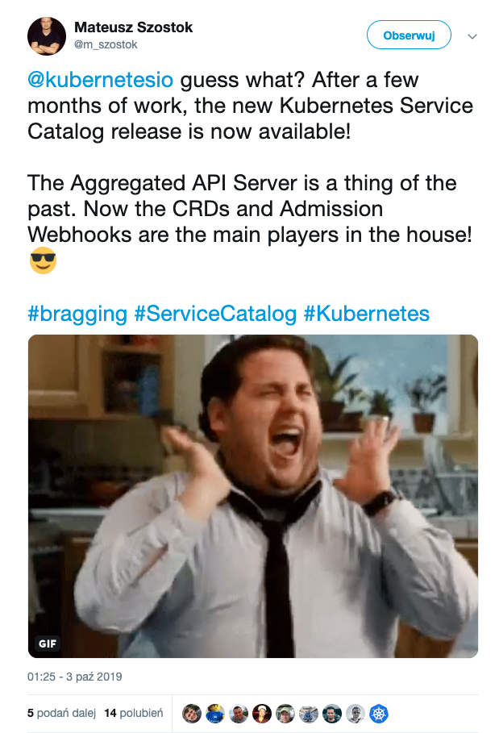
New architecture in place!

Slide 34
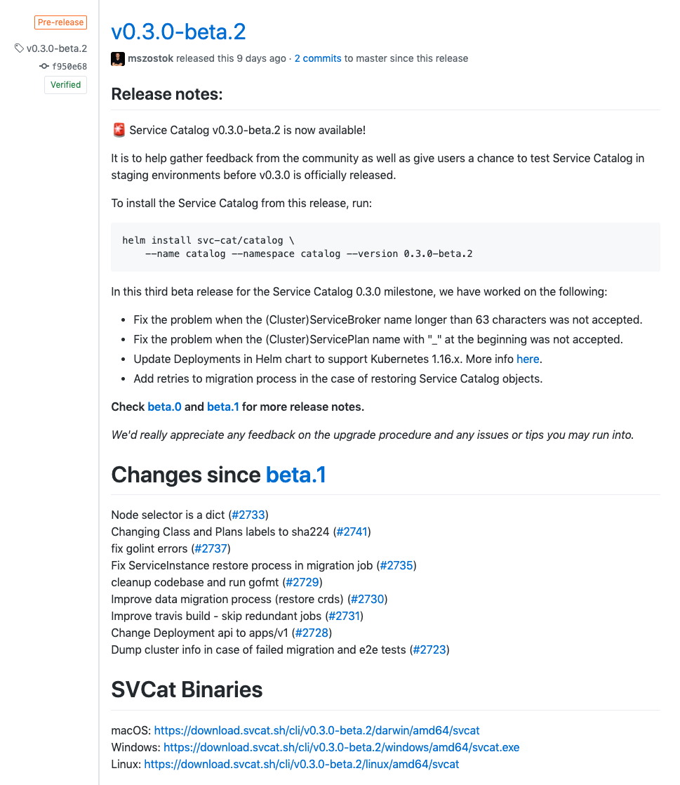
New architecture in place!

Slide 35
?
How do these plans affect you

Slide 36
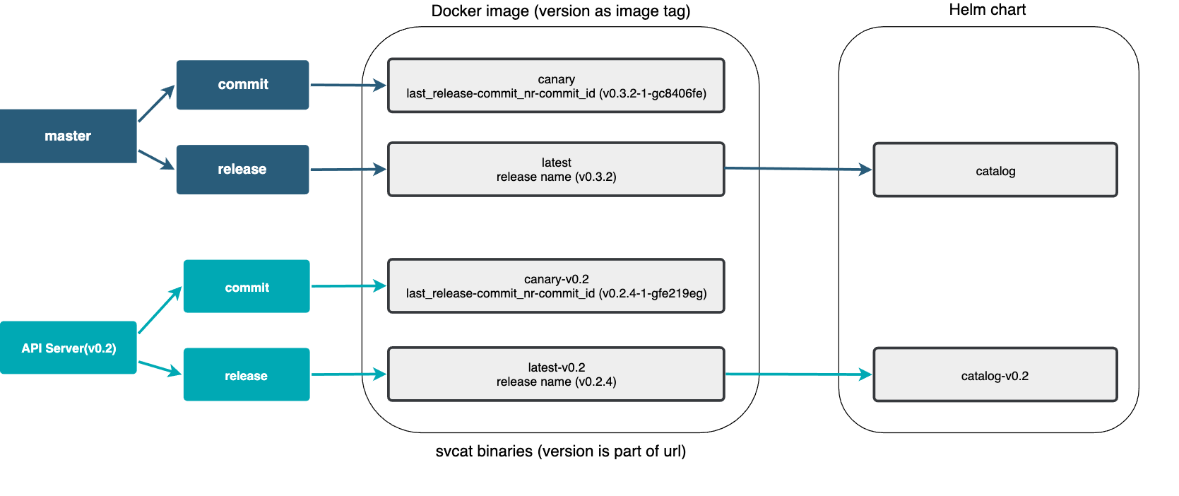
How these plans affect you
Notes:
Describe the new release process and point out that we have now catalog Helm Chart and catalog-0.2 Helm Chart (it is worth mentioning because it’s not clear for some of our clients)

Slide 37
How these plans affect you
master (v0.3 - CRDs) v0.2 (api-server)
helm install svc-cat/catalog \
--name catalog --namespace catalog
helm upgrade catalog svc-cat/catalog
helm install svc-cat/catalog-v0.2 \
--name catalog --namespace catalog
helm upgrade catalog svc-cat/catalog-v0.2
Notes:
Show the difference between the installations

Slide 38
Seamless upgrade for our clients
How these plans affect you
$ helm upgrade catalog ./chart/service-catalog

Slide 39
How these plans affect you
The old API Server-based implementation is available on the v0.2 branch.
We support this implementation by providing bug fixes until July 2020.

Slide 40
New subprojects in SIG-Service Catalog

Slide 41
Subproject Minibroker
Minibroker is an implementation of the Open Service Broker API suited for local development and testing.
We use it in the official Service Catalog walkthrough documentation.
Repository: https://github.com/kubernetes-sigs/minibroker
Previously it was a personal project maintained by @carolynvs. She has graciously decided to donate it to Kubernetes.

Slide 42
Subproject go-open-service-broker-client
Go Open Service Broker Client is a Go client for communicating with service brokers which implements the Open Service Broker API.
We use it in the Service Catalog controllers.
Repository: https://github.com/kubernetes-sigs/go-open-service-broker-client
Previously it was a project created by a Service Catalog contributor, @pmorie. He has graciously decided to donate it to Kubernetes.

Slide 43
What else is new
The repository was moved from kubernetes-incubator to kubernetes-sigs.
Update your forked project location! ☺

Slide 44
Design Issue - Deleting the Service Instance
Current approach:
Fail the deprovision operation if the given ServiceInstance still has associated ServiceBindings.
Problem:
The ServiceInstance is marked for deletion and this status cannot be reverted. As a result, you cannot update that ServiceInstance and you cannot create a new ServiceBinding for it.
Notes:
Present the new cascade deletion proposal to them and ask for feedback

Slide 45
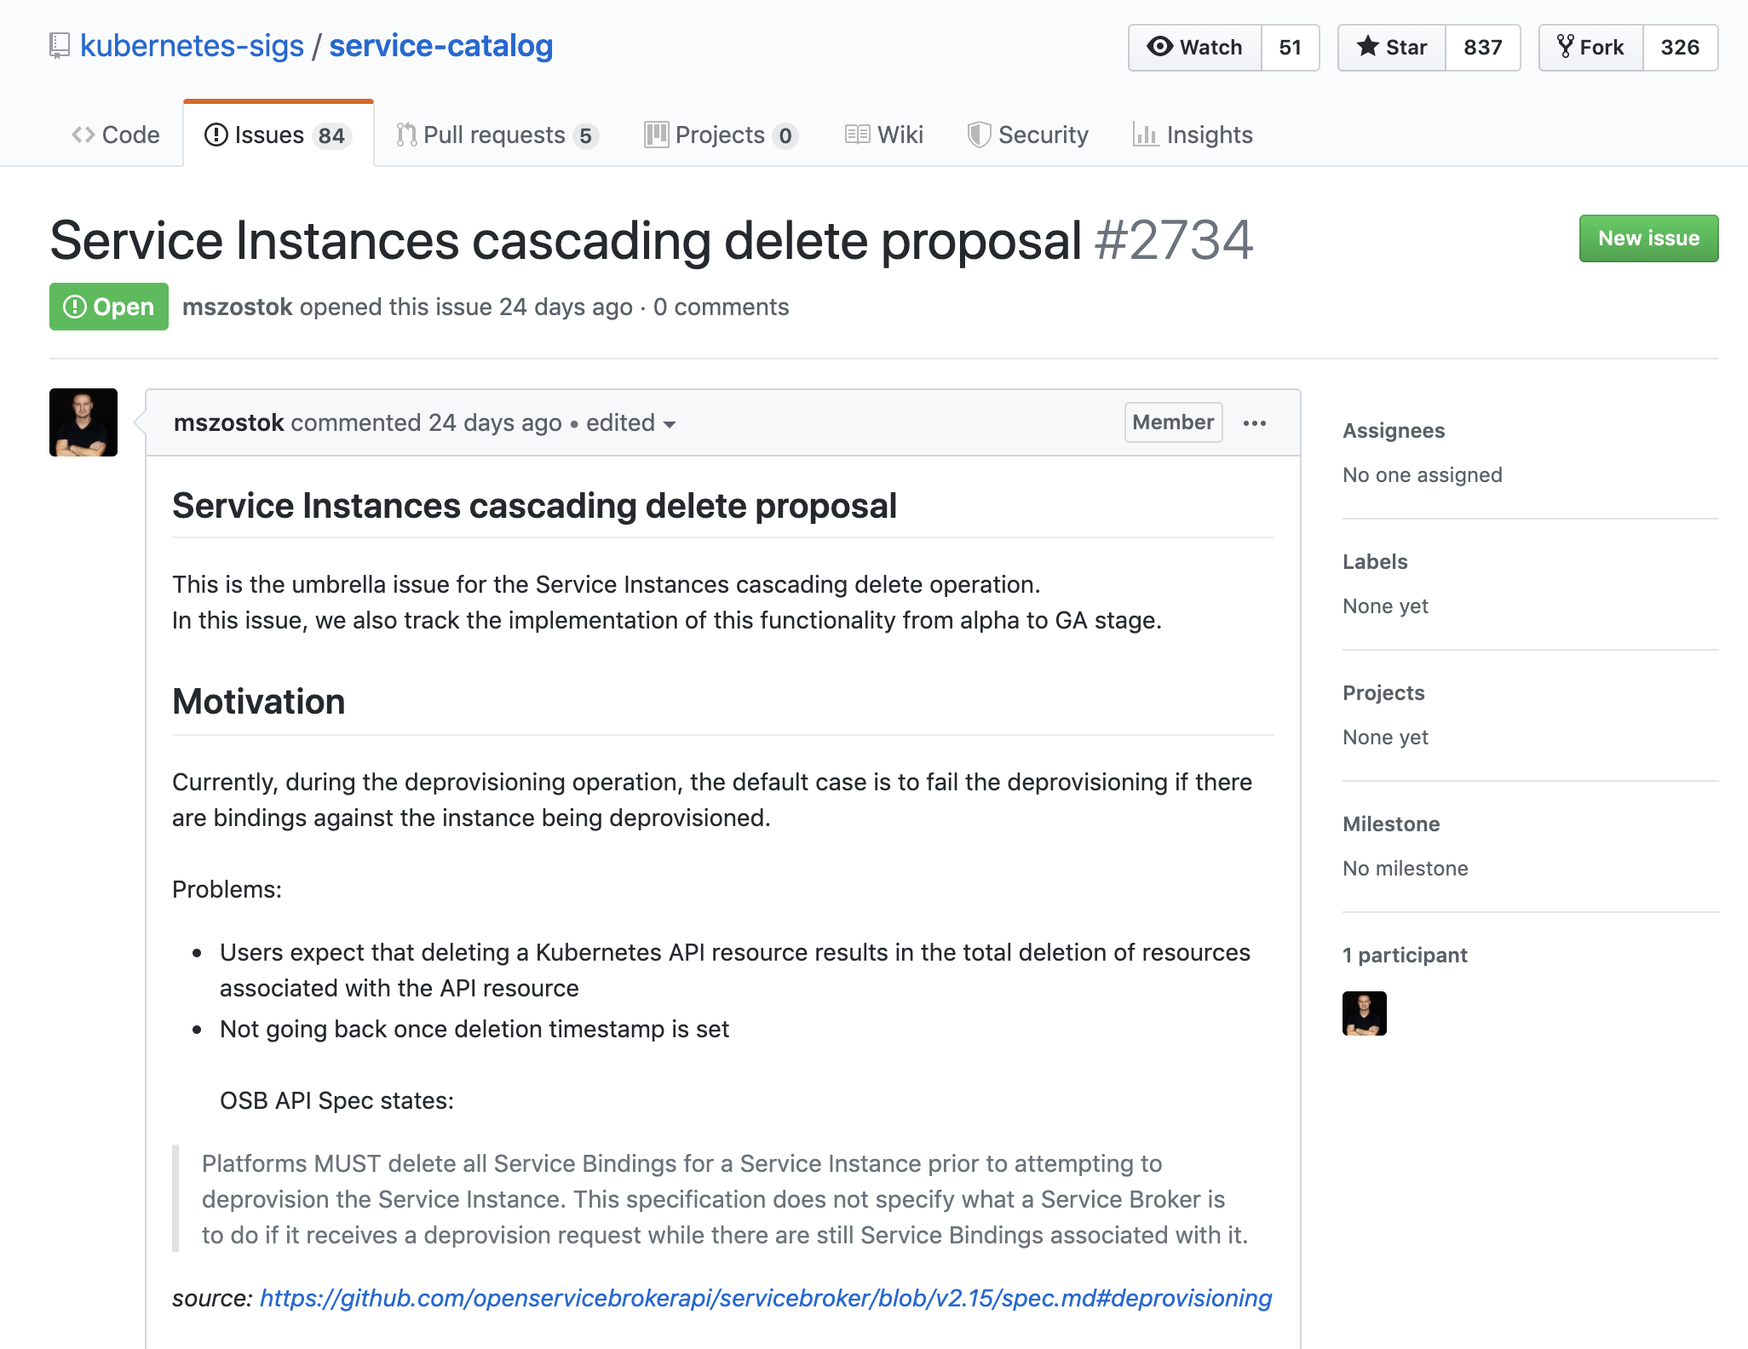

Cascade Deletion Proposal

Slide 46
Alternative?
Implement a validation admission webhook which will block the DELETION request
if a given ServiceInstance has associated ServiceBindings.
Notes:
Describe the available alternative

Slide 47
Design Issue - GUIDs vs. Names
Kubernetes names are fixed
OSB API resources have mutable names, and fixed GUIDs
Service Catalog types use OSB API GUID as the name, and have a mutable ExternalName field
svcat cli tool alleviates this pain by referencing human-readable ExternalNames as much as possible
metadata:
name: 12kbac-adad12kbasd // from the broker; immutable
uid: affd6f9b-defe-11e8-87bb-0242ac110007 // generated by Kube
spec:
externalName: mysql // from the broker; can change
externalID: 12kbac-adad12kbasd // same as metadata.name

Slide 48
Next plans – milestone 0.3.0
Documentation enhancements (compliance with official guidelines, doc structure clean-up , etc.)
Compliance with the new Open Service Broker API 2.15
CI pipelines clean-up (probably get rid of Travis and use only Prow)
Migration of Service Catalog resources under the SIG control
https://svcat.io → https://svcat.sigs.k8s.io
https://download.svcat.sh → https://download.svcat.sigs.k8s.io (final URL may differ)
Decision on the future of the PodPresets functionality

Slide 49
General Info
Become a Service Catalog contributor! ☺
Regular SIG Meeting: Mondays at 9:00AM PT (Pacific Time) (weekly).
Convert to your timezone.

Slide 50
General Info
Chairs
Jonathan Berkhahn - jaberkha@us.ibm.com - @jberkhahn
Mateusz Szostok - mateusz.szostok@sap.com - @mszostok
Home page: https://svc-cat.io
GitHub repo: https://github.com/kubernetes-sigs/service-catalog
Slack channel: https://kubernetes.slack.com/messages/sig-service-catalog
List: https://groups.google.com/forum/#!forum/kubernetes-sig-service-catalog
OSB API Spec: https://www.openservicebrokerapi.org/

